Slide 1
Calplug EMS Team Meeting
Charles Lam
6/3/13

Slide 2
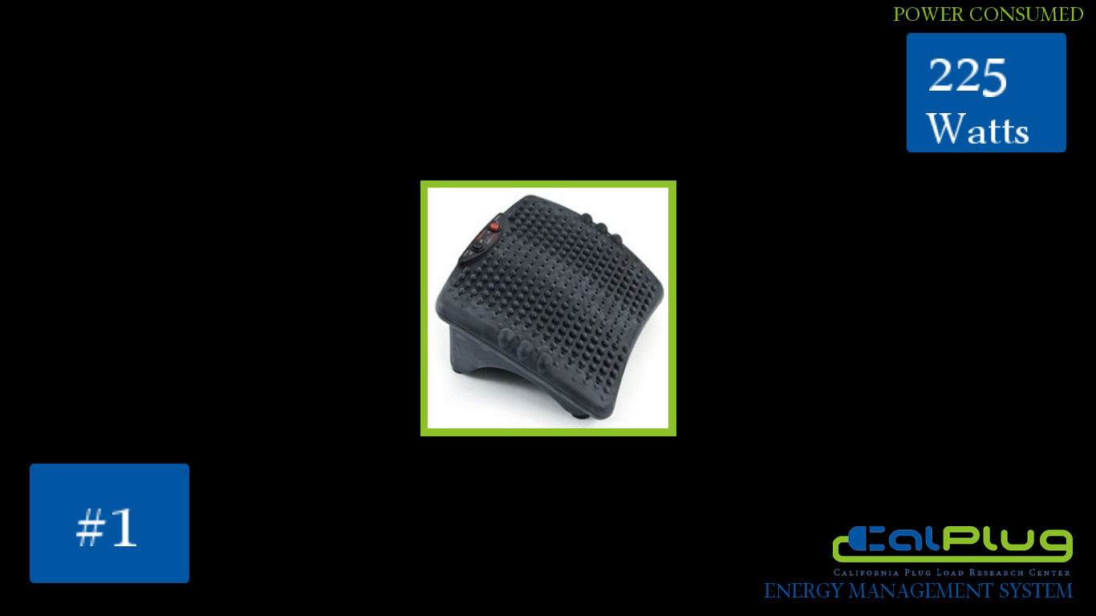

Slide 3
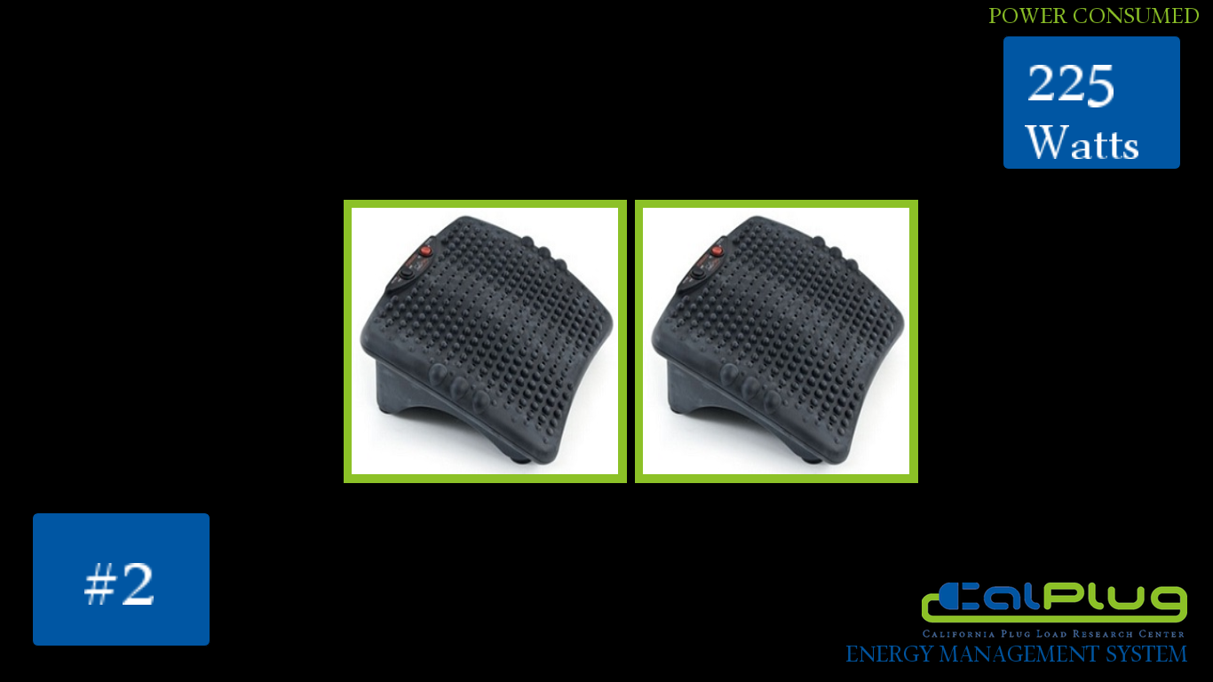

Slide 4


Slide 5


